Slide 1

Tradeoff analysis between Quality-of-Control and degree of approximate computing for image based control systems
Dip Goswami, Sajid Mohamed, Sayandip De
Eindhoven University of Technology, The Netherlands

Slide 2
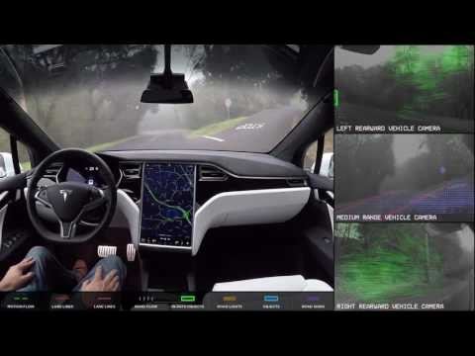
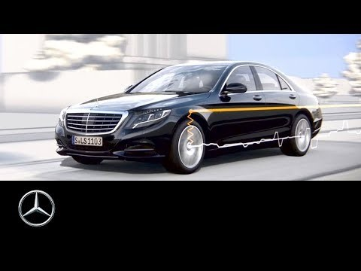
Image-in-the-loop

Slide 3
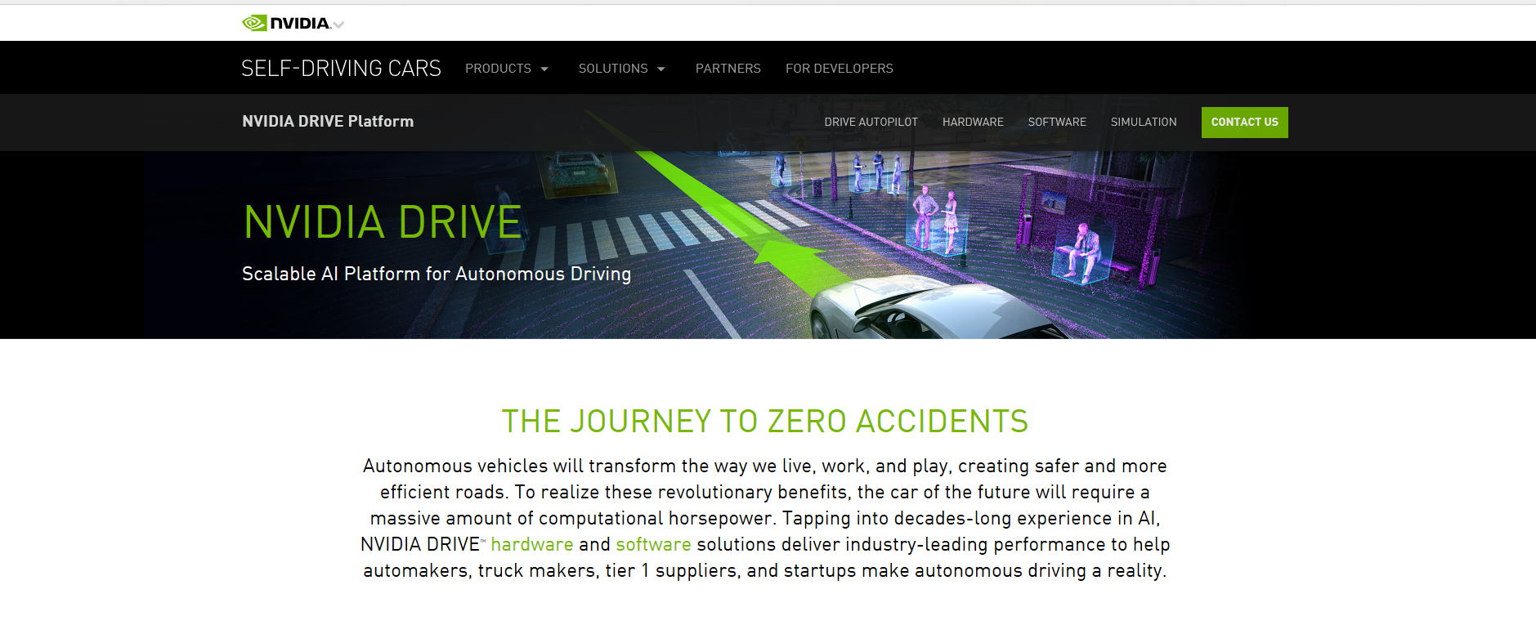
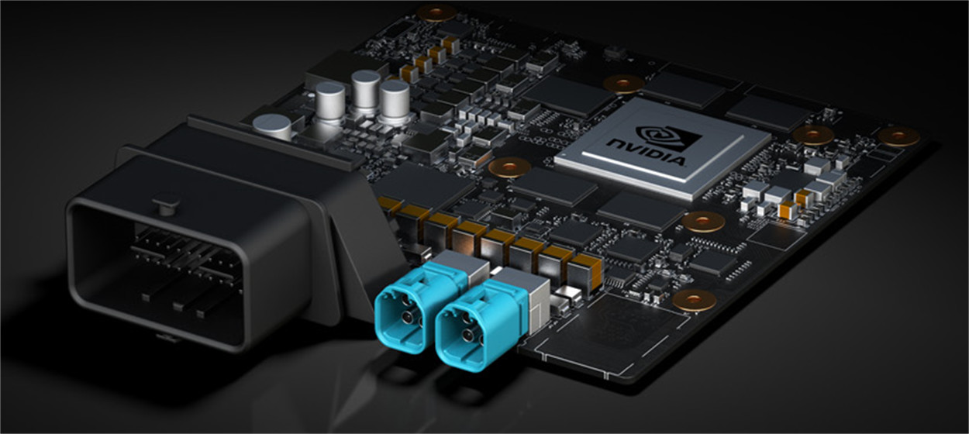
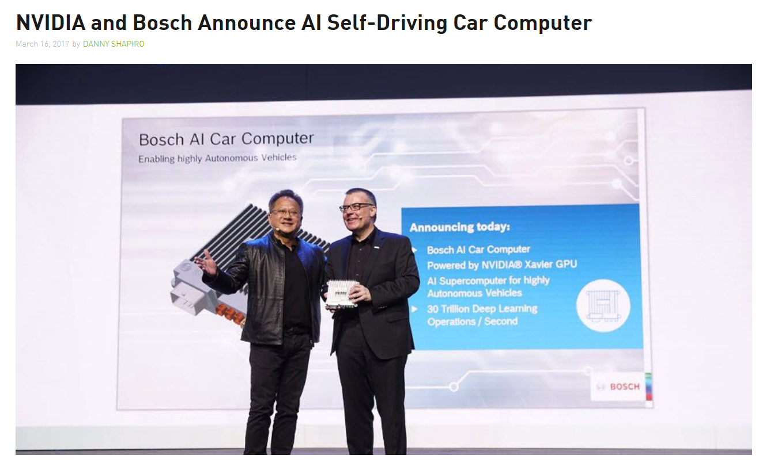
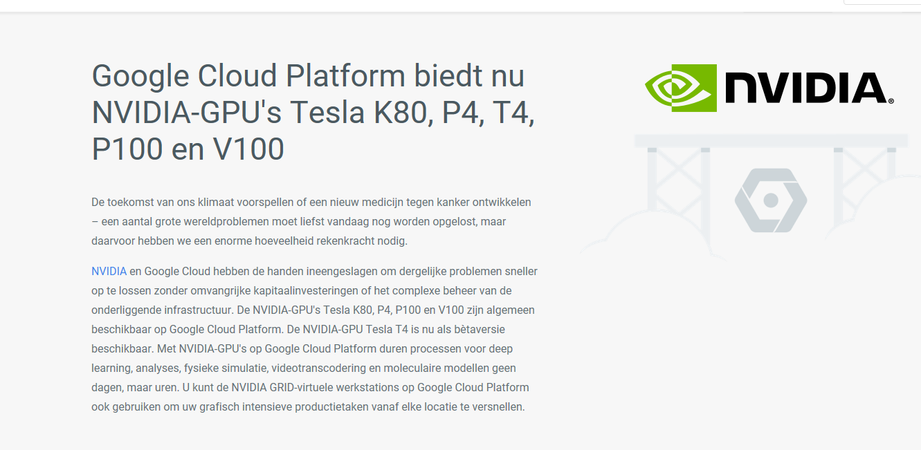
Processing platforms

Slide 4
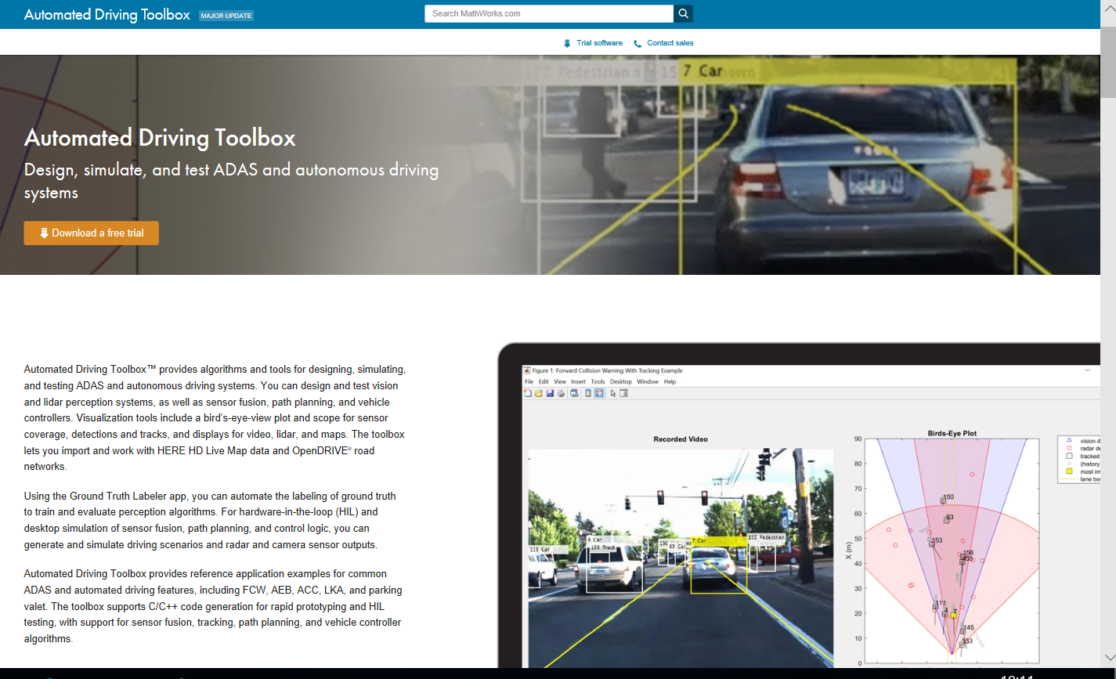
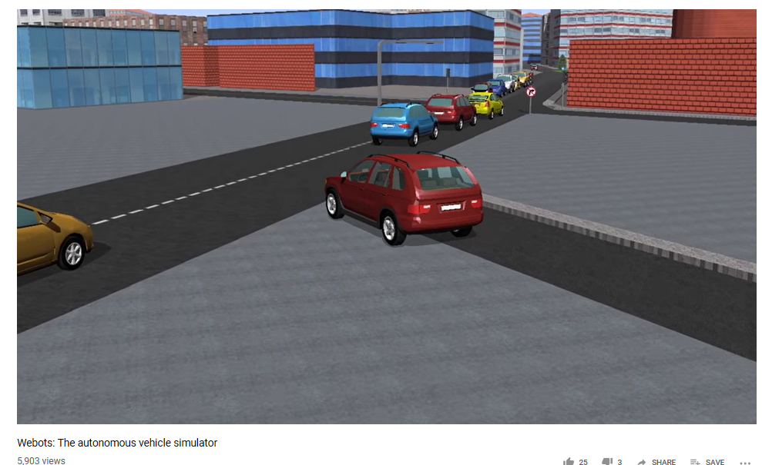
Image-based application development

Slide 5
Key points
Image-based systems are the key ingredients in the next-gen autonomous cars
Huge processing demand at runtime
Current car processing platforms (ECUs) cannot handle the processing demand
There is a huge industrial interest in developing processing platforms – e.g., Nvdia drive
There is a huge industrial effort in helping the application development – e.g., matlab, webots
Cost is the major bottleneck to bring such technologies to affordable cars
One key factor is to do pay attention in the application development side – image-based control is an example!

Slide 6
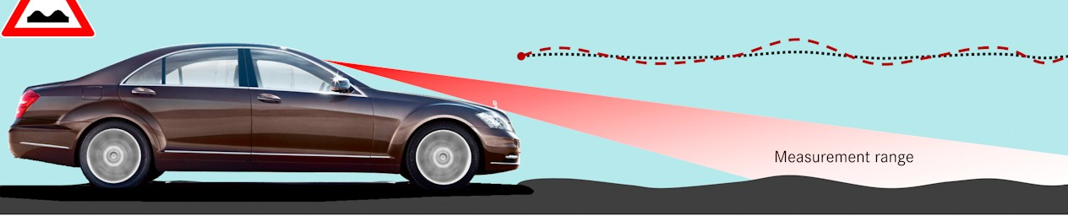
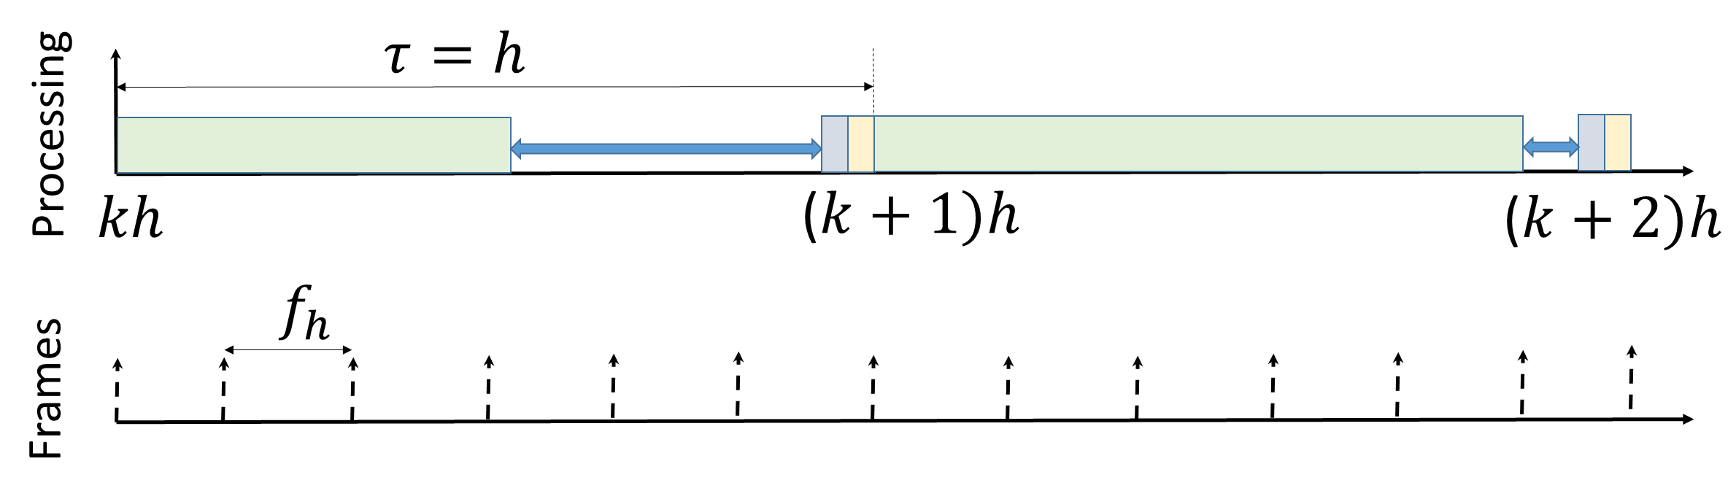
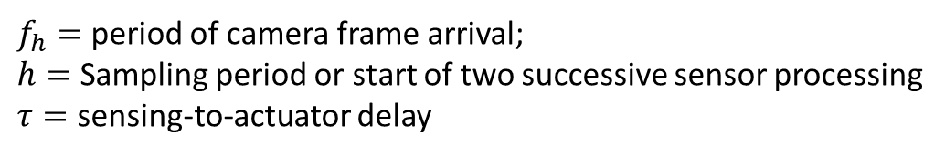


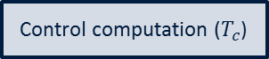
Image-based control (IBC)
3
Sensing ($T_{s}$)
Control computation ($T_{c}$)
https://www.mercedesofsalem.com/blog/mercedes-benz-magic-body-control/
Actuation ($T_{a}$)
$f_{h}=$ period of camera frame arrival;
$h=$ Sampling period or start of two successive sensor processing
$τ=$ sensing-to-actuator delay

Slide 7
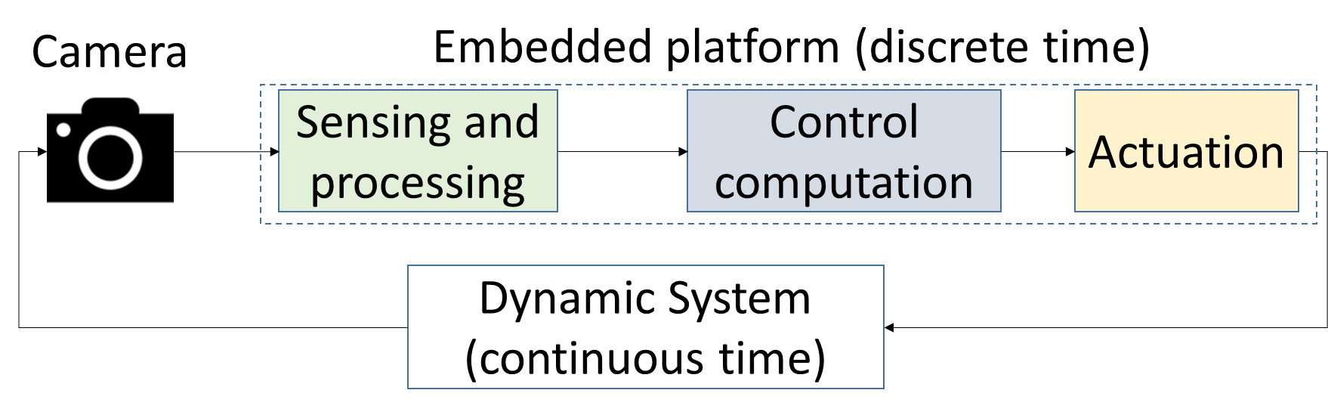
Image-based control – embedded processing
4

Slide 8
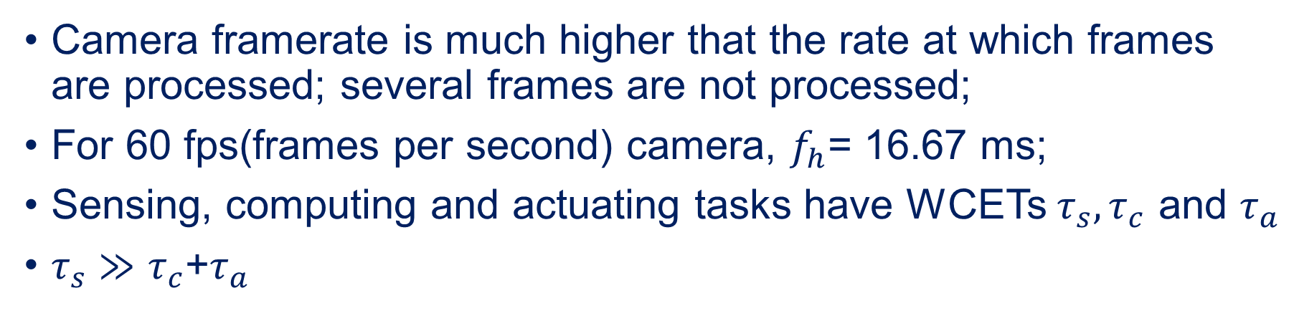
Image-based control – timing challenges
5
Camera framerate is much higher that the rate at which frames are processed; several frames are not processed;
For 60 fps(frames per second) camera, $f_{h}$= 16.67 ms;
Sensing, computing and actuating tasks have WCETs $τ_{s},τ_{c}$ and $τ_{a}$
$τ_{s}≫τ_{c}$+$τ_{a}$

Slide 9
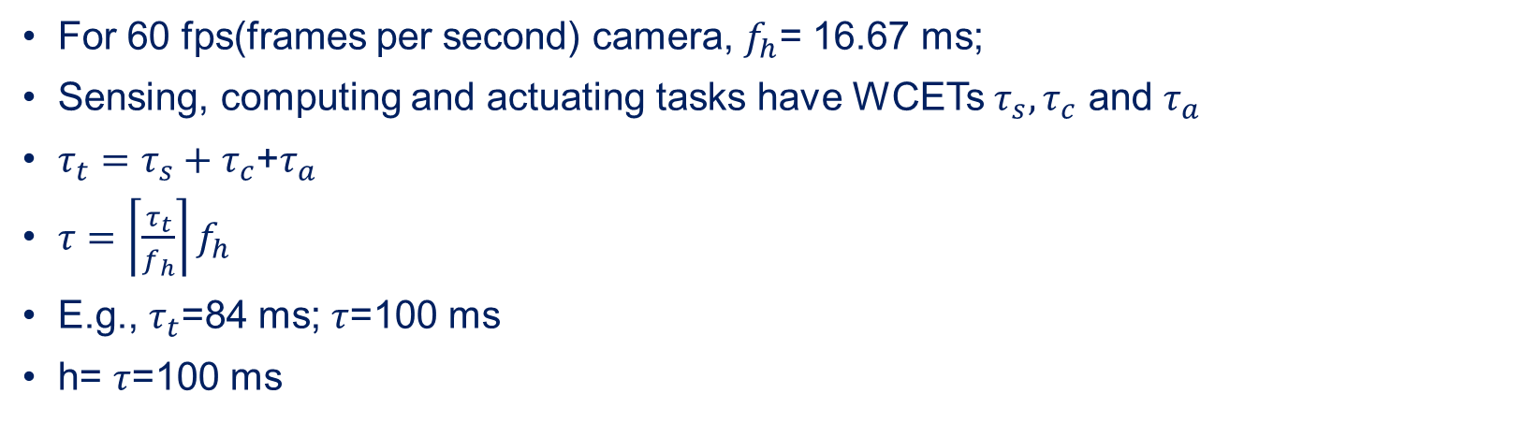
Image-based control – example
6
For 60 fps(frames per second) camera, $f_{h}$= 16.67 ms;
Sensing, computing and actuating tasks have WCETs $τ_{s},τ_{c}$ and $τ_{a}$
${τ_{t}=τ}_{s}+τ_{c}$+$τ_{a}$
$τ=\left\lceil \frac{τ_{t}}{f_{h}}\right\rceil f_{h}$
E.g., $τ_{t}$=84 ms; $τ$=100 ms
h= $τ$=100 ms

Slide 10
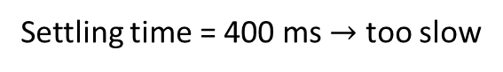


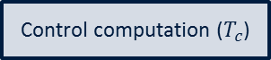
Response with h= $τ$=100 ms
7
Height of the road surface
read by the camera
Settling time = 400 ms $→$ too slow
Sensing ($T_{s}$)
Control computation ($T_{c}$)
Actuation ($T_{a}$)

Slide 11
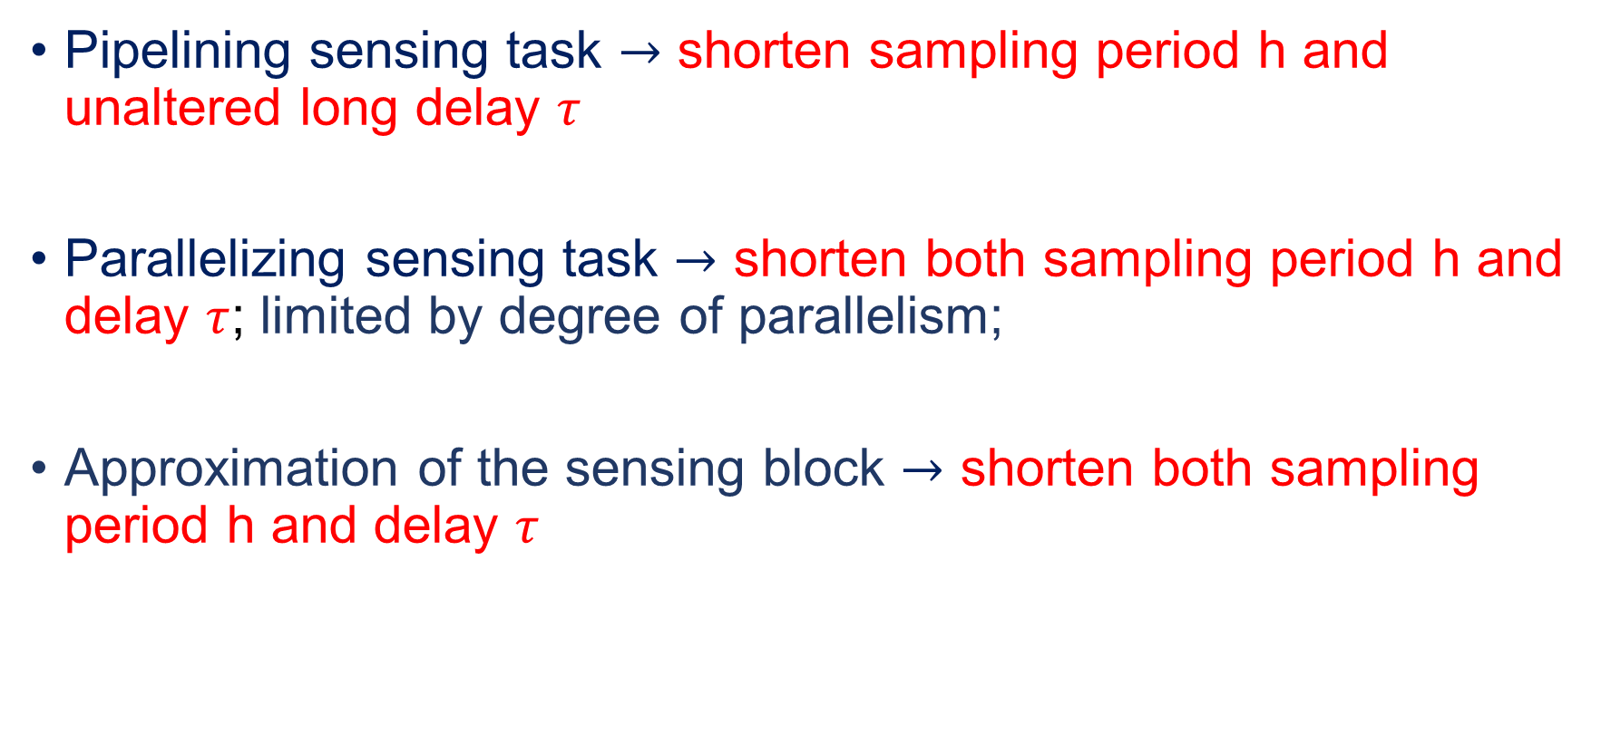
What can we do?
8
Pipelining sensing task $→$ shorten sampling period h and unaltered long delay $τ$
Parallelizing sensing task $→$ shorten both sampling period h and delay $τ$; limited by degree of parallelism;
Approximation of the sensing block $→$ shorten both sampling period h and delay $τ$

Slide 12
Model-based control systems
Background knowledge

Slide 13
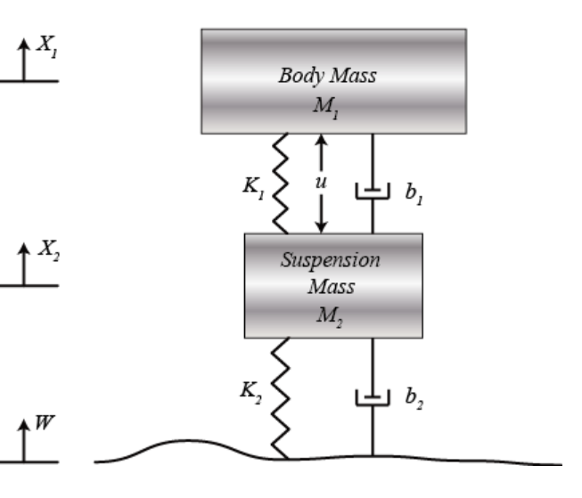
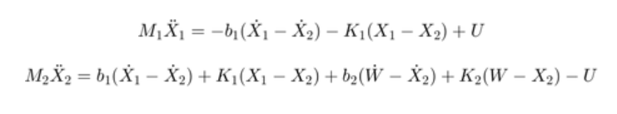
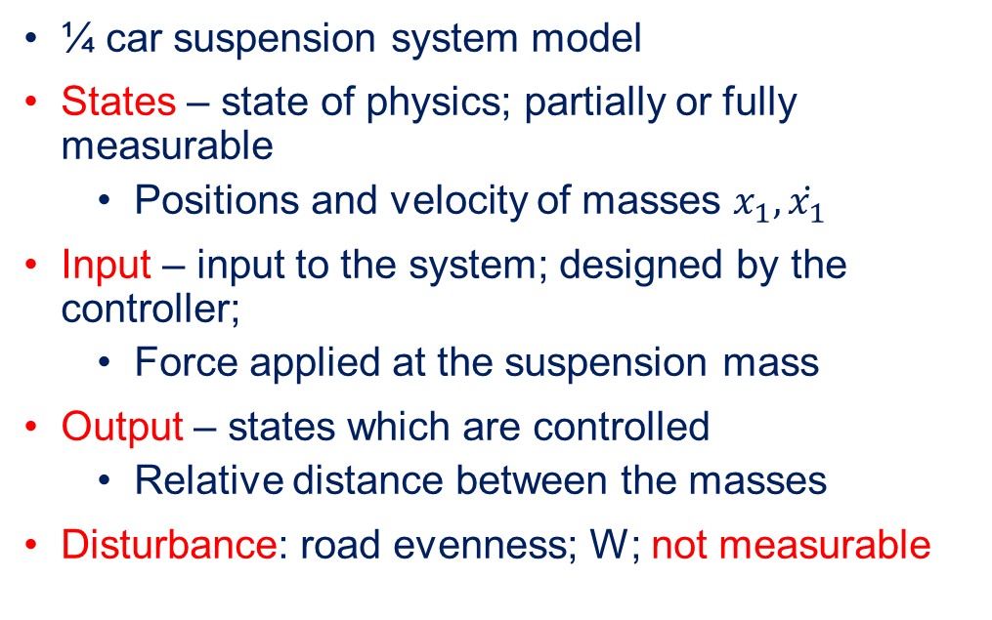
Model of physics – example
¼ car suspension system model
States – state of physics; partially or fully measurable
Positions and velocity of masses $x_{1},\dot{x_{1}}$
Input – input to the system; designed by the controller;
Force applied at the suspension mass
Output – states which are controlled
Relative distance between the masses
Disturbance: road evenness; W; not measurable
http://ctms.engin.umich.edu/CTMS/index.php?example=Suspension&section=ControlStateSpace

Slide 14
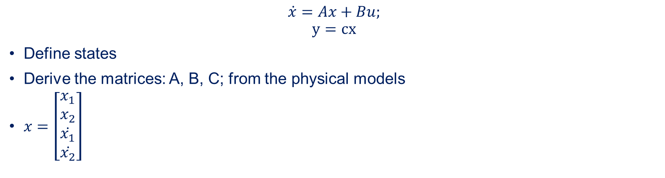
State-space model
$$\dot{x}=Ax+Bu;$$
$$y=cx$$
Define states
Derive the matrices: A, B, C; from the physical models
$x=\left[\begin{aligned}x_{1} \\ x_{2} \\ \dot{x_{1}} \\ \dot{x_{2}}\end{aligned}\right]$
We ignored W since it can be measured by camera
A=[0 1 0 0
-(b1*b2)/(m1*m2) 0 ((b1/m1)*((b1/m1)+(b1/m2)+(b2/m2)))-(k1/m1) -(b1/m1)
b2/m2 0 -((b1/m1)+(b1/m2)+(b2/m2)) 1
k2/m2 0 -((k1/m1)+(k1/m2)+(k2/m2)) 0];
B=[0;
1/m1;
0;
(1/m1)+(1/m2)];
C=[0 0 1 0];

Slide 15
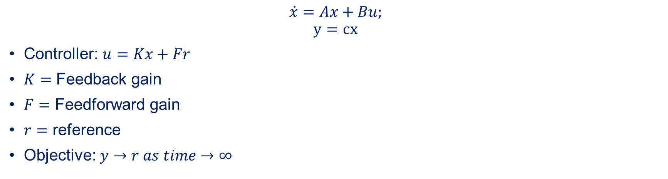
Feedback control
$$\dot{x}=Ax+Bu;$$
$$y=cx$$
Controller: $u=Kx+Fr$
$K=$ Feedback gain
$F=$ Feedforward gain
$r=$ reference
Objective: $y→r as time→∞$

Slide 16






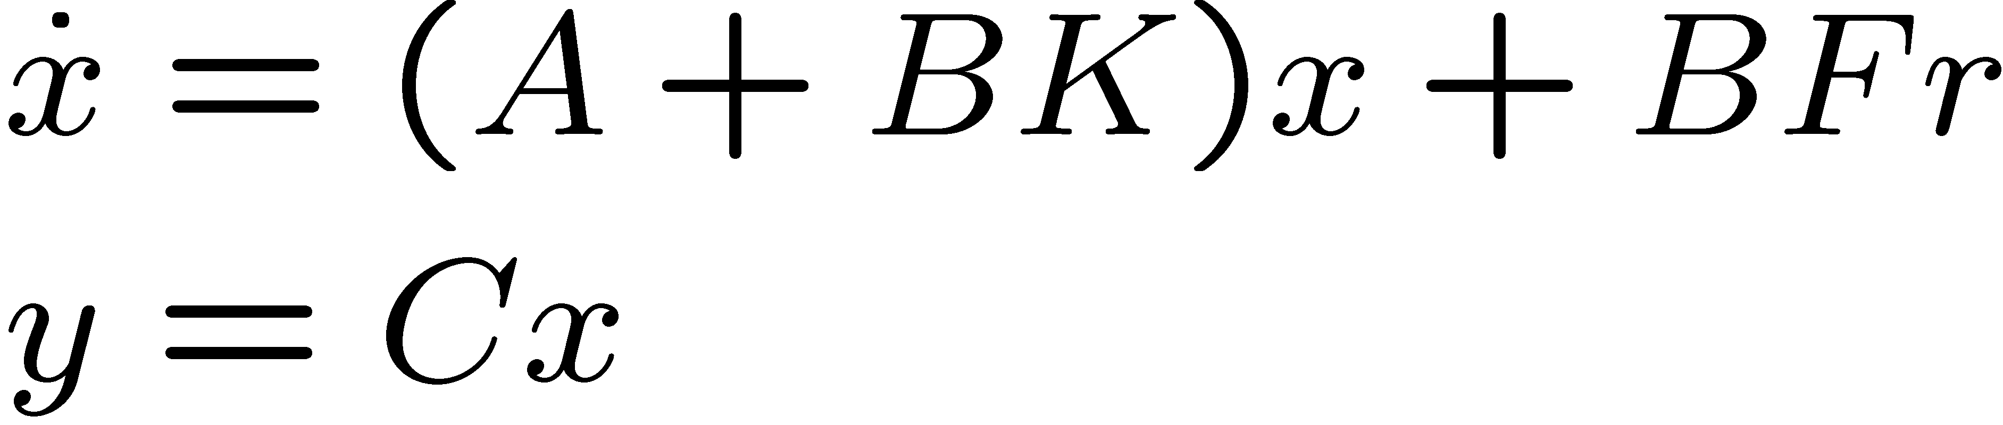
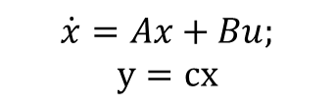
Closed-loop system
16
+
+
$$\dot{x}=Ax+Bu;$$
$$y=cx$$
r
F
B
C
+
+
A
K
Closed-loop system with state feedback control: ,

Slide 17
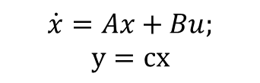
Discrete-time implementation
17
$$\dot{x}=Ax+Bu;$$
$$y=cx$$
Continuous-time
r
+
+
C
F
B
+
+
A
K
Discrete-time
Updated at discrete-time points -> interval between 2 consecutive updates is sampling period h

Slide 18
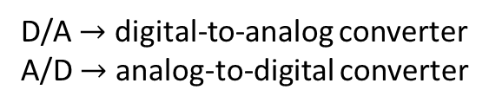
Digital implementation: Sample and Hold
18
Processor clock
u(t_{k})
u(t)
x(t)
x(t_{k})
D/A
Hold
Continuous-time
system
Sampler
A/D
Control
Algorithm
D/A $→$ digital-to-analog converter
A/D $→$ analog-to-digital converter
Input u(t) is piecewise constant
Look at the sampling points

Slide 19
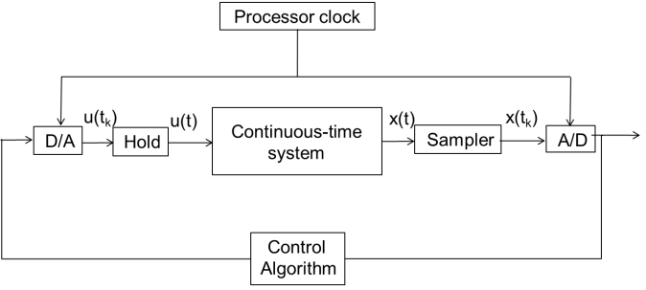
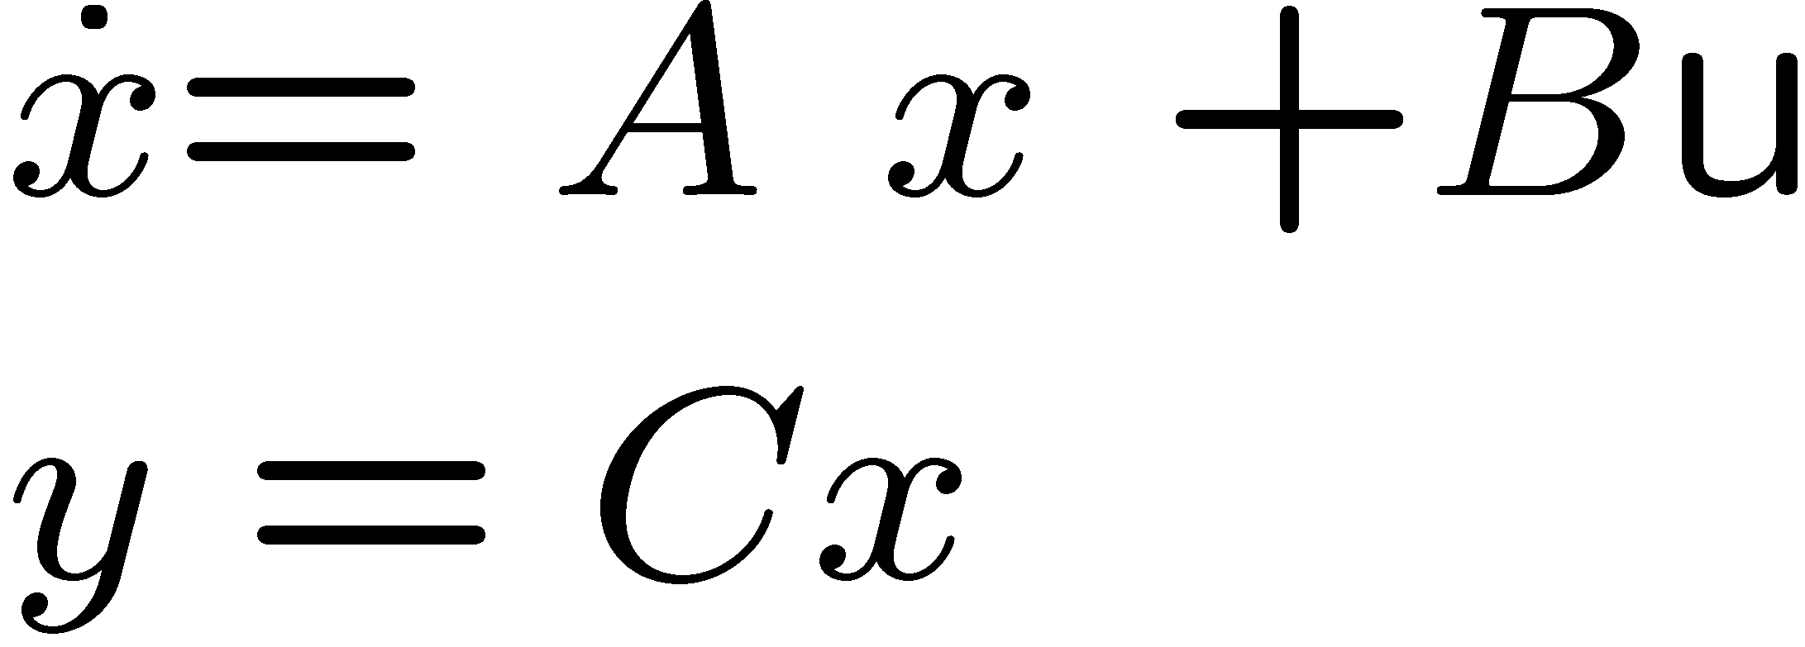
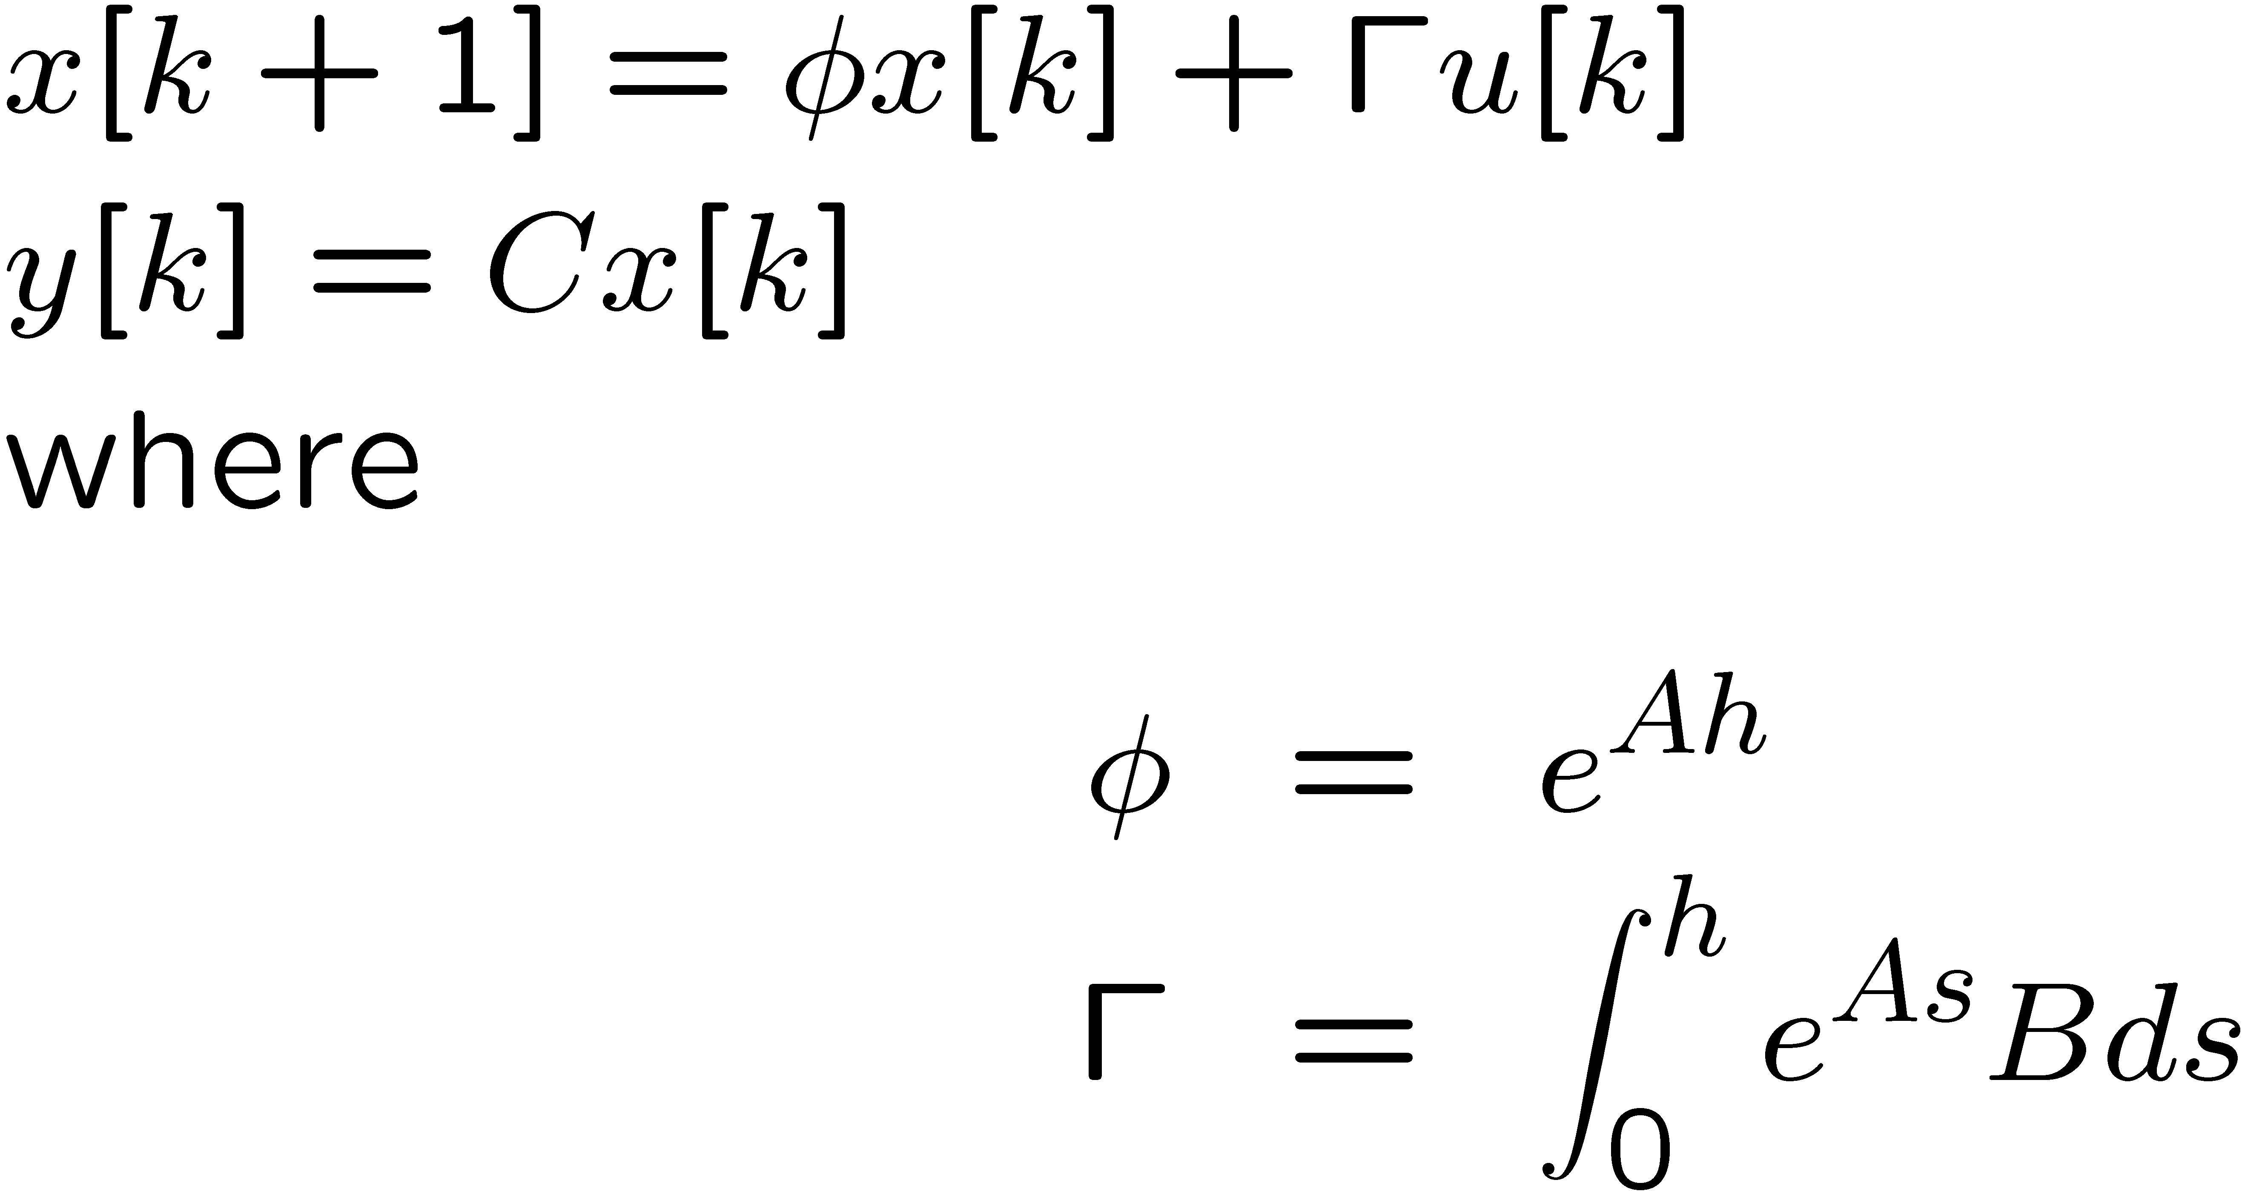
Discretized model
19
ZOH periodic sampling with period = h

Slide 20
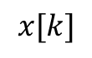
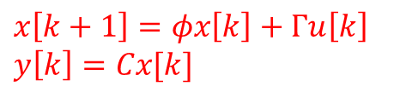
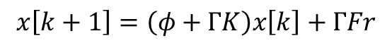
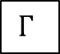
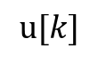
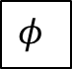
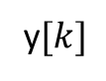
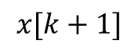
Discrete-time control
20
$$x\left[k+1\right]=φx\left[k\right]+Γu\left[k\right]$$
$$y\left[k\right]=Cx[k]$$
+
$$u[k]$$
$$x[k+1]$$
$$x[k]$$
r
F
$$Γ$$
Delay
C
y$[k]$
+
$$φ$$
K
Open-loop system, i.e., with u[k]=0 $→x\left[k+1\right]=φx[k]$
Closed-loop system with state-feedback control $u\left[k\right]=Kx\left[k\right]+Fr$
$$x\left[k+1\right]=\left(φ+ΓK\right)x\left[k\right]+ΓFr$$
r = reference
K = feedback gain
F = feedforward gain

Slide 21
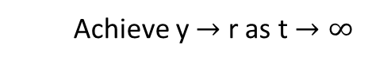
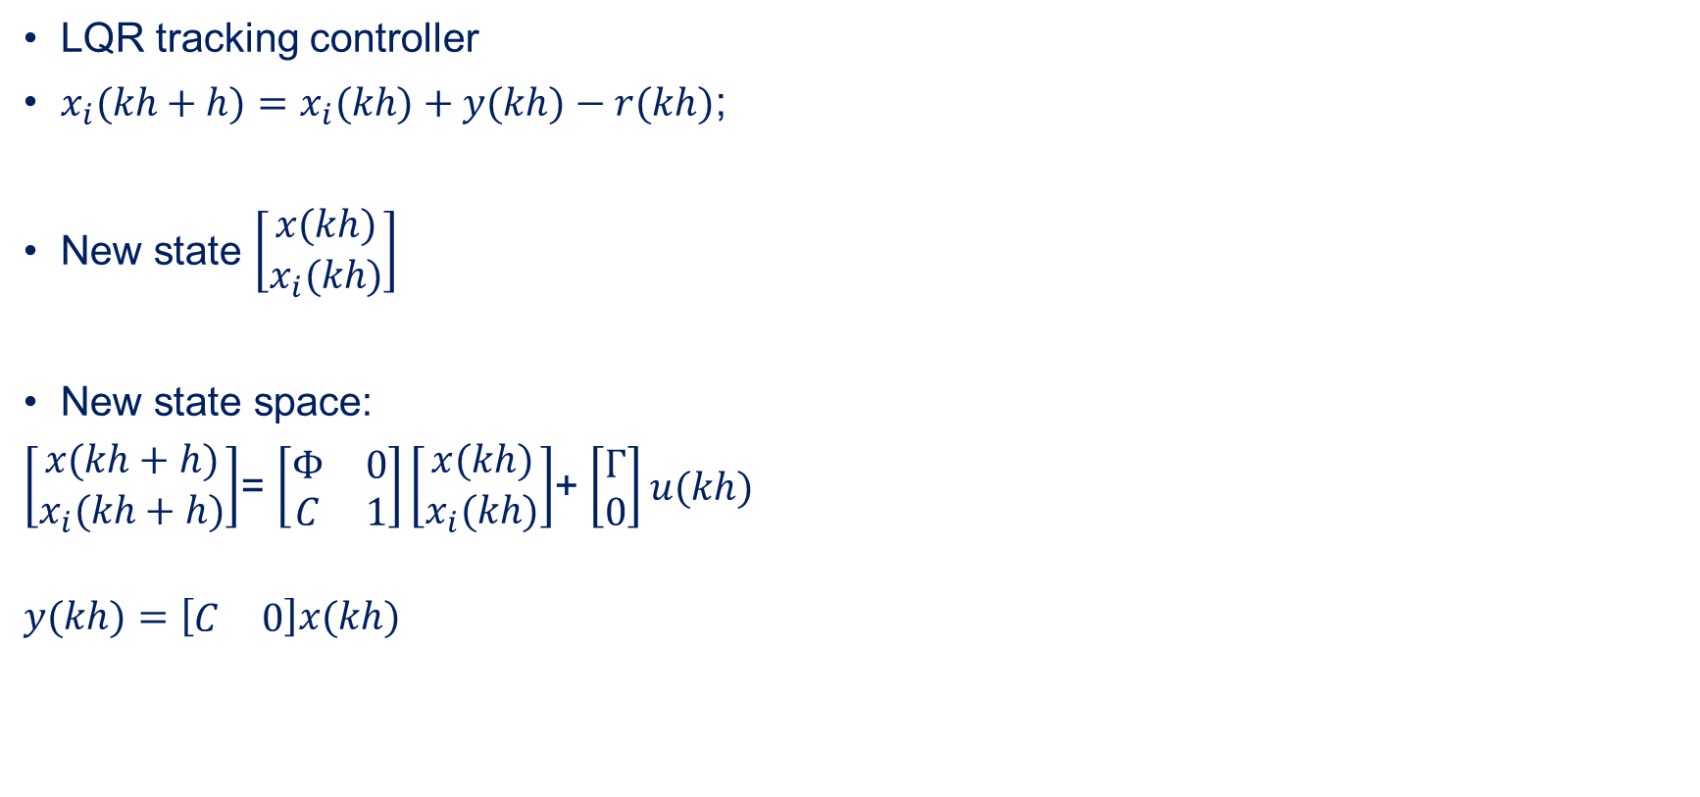
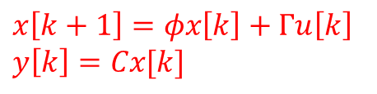
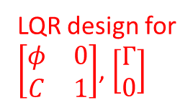
Controller design: LQR tracking
27
LQR tracking controller
$x_{i}(kh+h)=x_{i}(kh)+y(kh)−r(kh)$;
New state $\left[\begin{aligned}x(kh) \\ x_{i}(kh)\end{aligned}\right]$
New state space:
$\left[\begin{aligned}x(kh+h) \\ x_{i}(kh+h)\end{aligned}\right]$= $\left[\begin{matrix}Φ & 0 \\ C & 1\end{matrix}\right]\left[\begin{aligned}x(kh) \\ x_{i}(kh)\end{aligned}\right]$+ $\left[\begin{aligned}Γ \\ 0\end{aligned}\right]u(kh)$
$$y(kh)=\left[\begin{matrix}C & 0\end{matrix}\right]x(kh)$$
Discretized model
$$x\left[k+1\right]=φx\left[k\right]+Γu\left[k\right]$$
$$y\left[k\right]=Cx[k]$$
Achieve y $→$ r as t $→∞$
LQR design for
$\left[\begin{matrix}φ & 0 \\ C & 1\end{matrix}\right]$, $\left[\begin{aligned}Γ \\ 0\end{aligned}\right]$

Slide 22
Image-based control: pipelined control

Slide 23
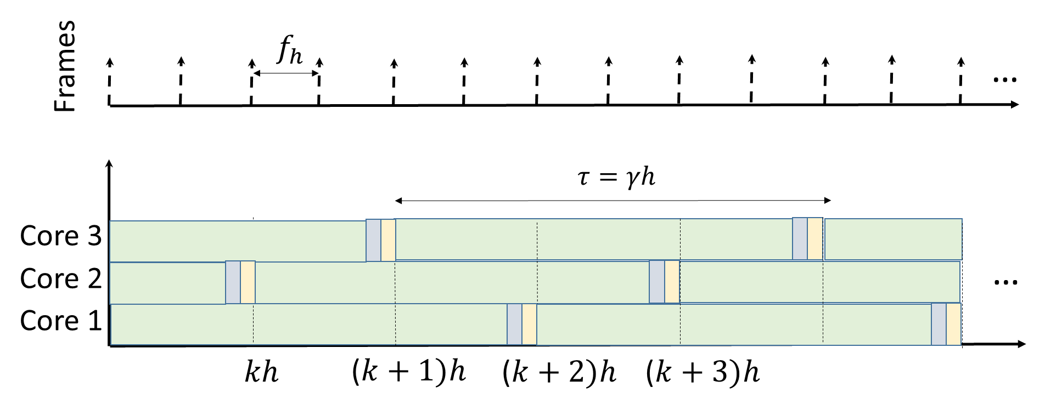
Pipelined control systems
9

Slide 24
Pipelined control systems
9
If frames can be processed independently, we can increase the rate of sensor-data processing by processing frames in parallel on multiple cores;
Sensor processing rate can be increased while the sensing delay remains long.

Slide 25
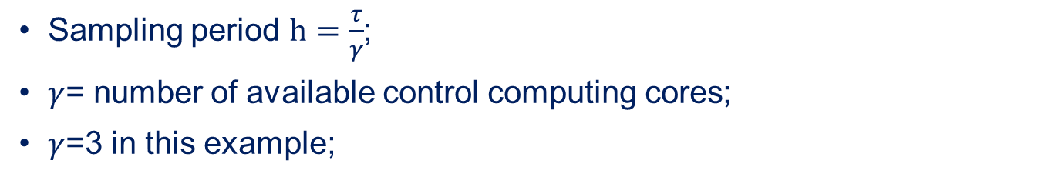
Pipelined control systems
9
Sampling period $h=\frac{τ}{γ}$;
$γ$= number of available control computing cores;
$γ$=3 in this example;

Slide 26
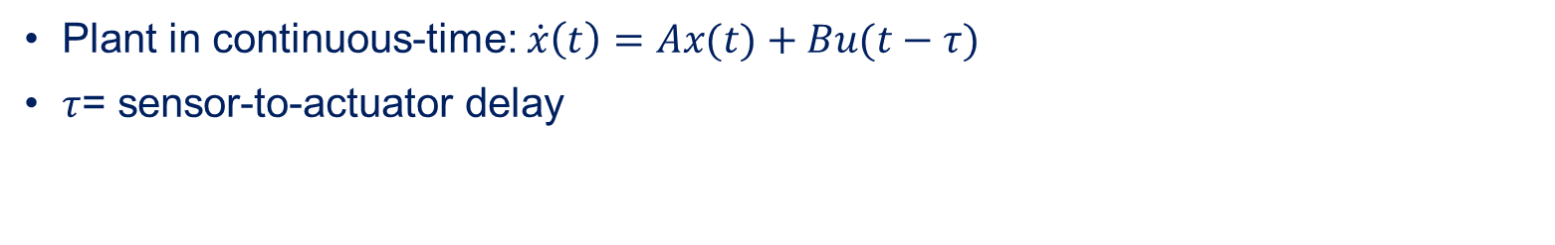
Pipelined control systems: model
9
Plant in continuous-time: $\dot{x}\left(t\right)=Ax(t)+Bu(t−τ)$
$τ$= sensor-to-actuator delay

Slide 27
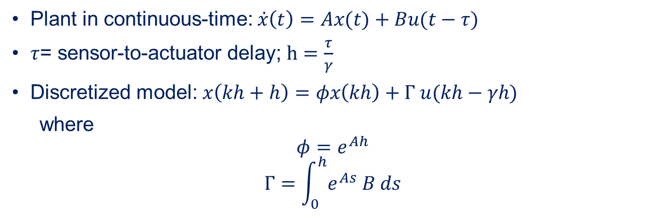
Pipelined control systems: model
9
Plant in continuous-time: $\dot{x}\left(t\right)=Ax(t)+Bu(t−τ)$
$τ$= sensor-to-actuator delay; $h=\frac{τ}{γ}$
Discretized model: $x\left(kh+h\right)=φx\left(kh\right)+Γ u(kh−γh)$
where
$$φ=e^{Ah}$$
$$Γ=\int_{0}^{h}{e^{As} B ds}$$

Slide 28
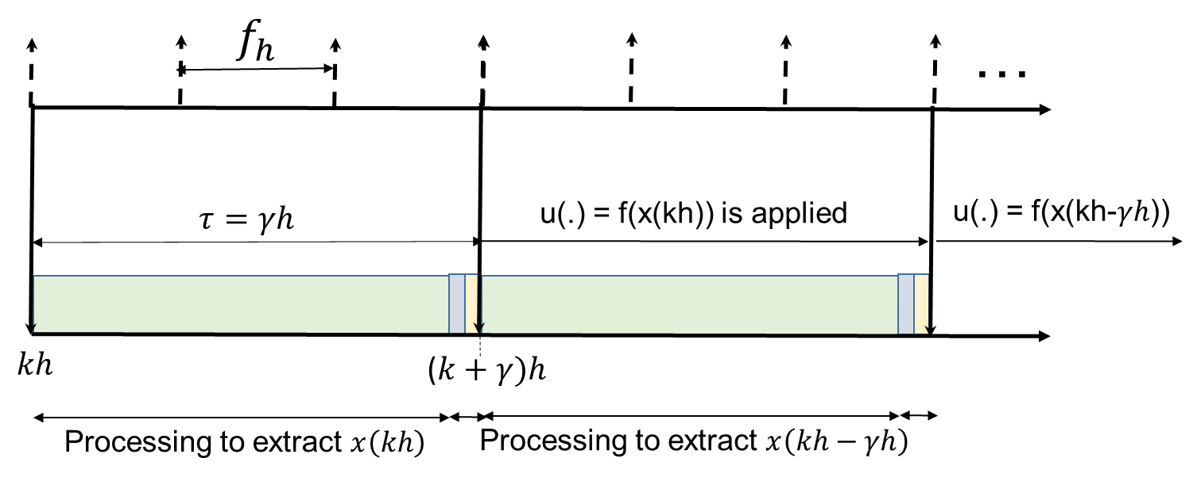
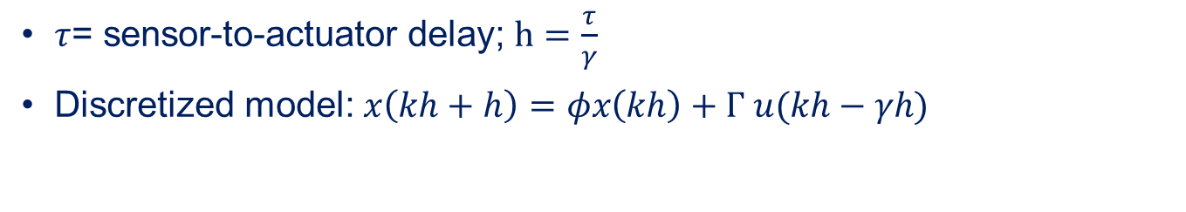
Pipelined control systems: timing and signals
9
$τ$= sensor-to-actuator delay; $h=\frac{τ}{γ}$
Discretized model: $x\left(kh+h\right)=φx\left(kh\right)+Γ u(kh−γh)$

Slide 29
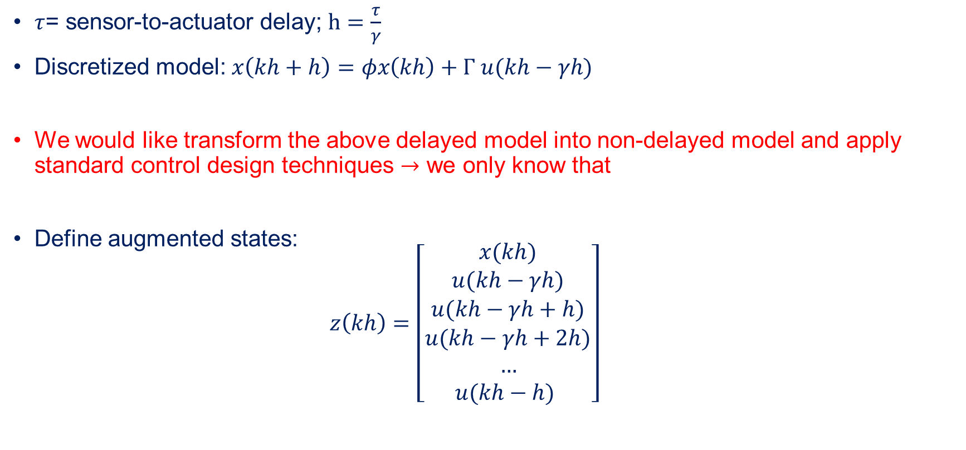
Pipelined control: model transformation
14
$τ$= sensor-to-actuator delay; $h=\frac{τ}{γ}$
Discretized model: $x\left(kh+h\right)=φx\left(kh\right)+Γ u(kh−γh)$
We would like transform the above delayed model into non-delayed model and apply standard control design techniques $→$ we only know that
Define augmented states:
$$z\left(kh\right)=\left[\begin{aligned}x(kh) \\ u(kh−γh) \\ u(kh−γh+h) \\ u(kh−γh+2h) \\ … \\ u(kh−h) \end{aligned}\right]$$

Slide 30
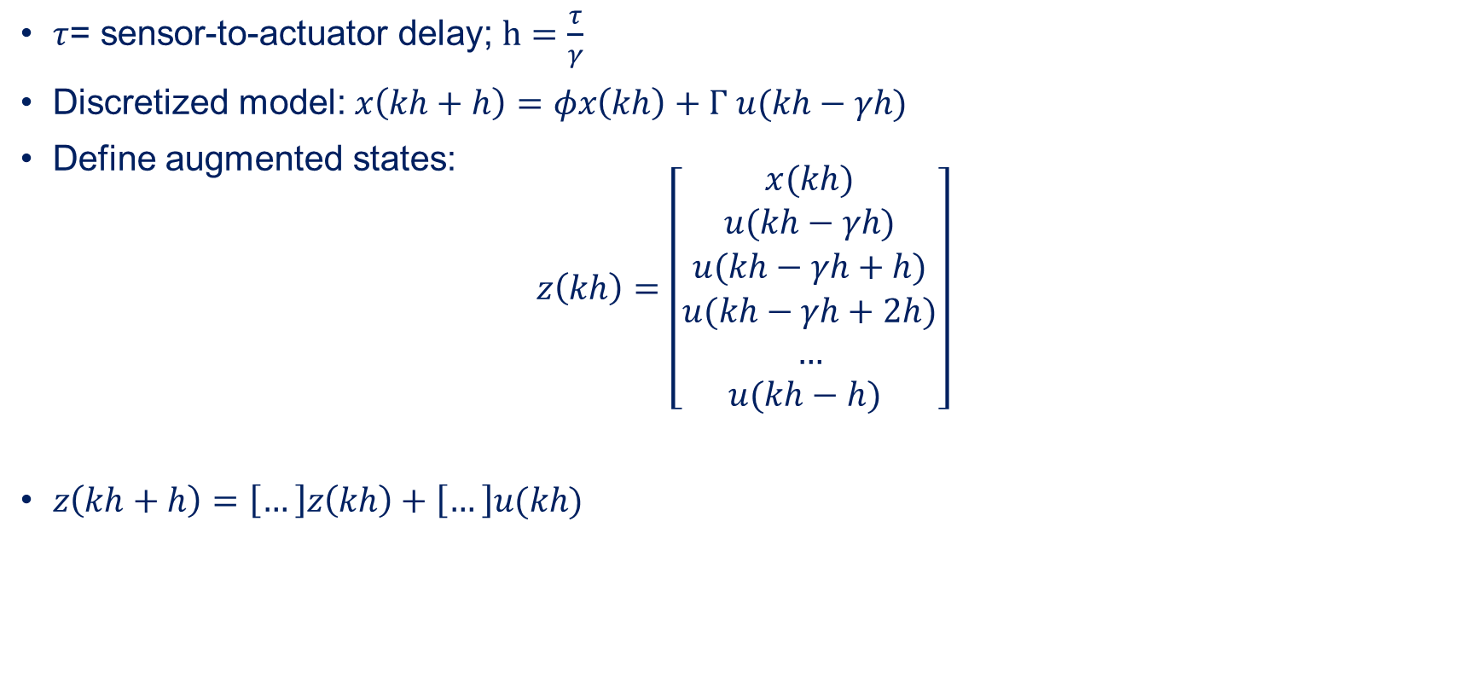
Pipelined control: model transformation
15
$τ$= sensor-to-actuator delay; $h=\frac{τ}{γ}$
Discretized model: $x\left(kh+h\right)=φx\left(kh\right)+Γ u(kh−γh)$
Define augmented states:
$$z\left(kh\right)=\left[\begin{aligned}x(kh) \\ u(kh−γh) \\ u(kh−γh+h) \\ u(kh−γh+2h) \\ … \\ u(kh−h) \end{aligned}\right]$$
$z\left(kh+h\right)=\left[…\right]z\left(kh\right)+\left[…\right]u(kh)$

Slide 31

Pipelined control: model transformation
16
Discretized model: $x\left(kh+h\right)=φx\left(kh\right)+Γ u(kh−γh)$
Define augmented states:
$$z\left(kh\right)=\left[\begin{aligned}x(kh) \\ u(kh−γh) \\ u(kh−γh+h) \\ u(kh−γh+2h) \\ … \\ u(kh−h) \end{aligned}\right]$$
$z\left(kh+h\right)=\left[\begin{aligned}x(kh+h) \\ u(kh−γh+h) \\ u(kh−γh+2h) \\ u(kh−γh+3h) \\ … \\ u(kh) \end{aligned}\right]=\left[\begin{aligned}φx\left(kh\right)+Γ u(kh−γh) \\ u(kh−γh+h) \\ u(kh−γh+2h) \\ u(kh−γh+3h) \\ … \\ u(kh) \end{aligned}\right]$

Slide 32

Pipelined control: model transformation
17
Discretized model: $x\left(kh+h\right)=φx\left(kh\right)+Γ u(kh−γh)$
$z\left(kh+h\right)=\left[\begin{aligned}x(kh+h) \\ u(kh−γh+h) \\ u(kh−γh+2h) \\ u(kh−γh+3h) \\ … \\ u(kh) \end{aligned}\right]=\left[\begin{aligned}φx\left(kh\right)+Γ u(kh−γh) \\ u(kh−γh+h) \\ u(kh−γh+2h) \\ u(kh−γh+3h) \\ … \\ u(kh) \end{aligned}\right]$
$z\left(kh+h\right)=\left[\begin{matrix}φ & Γ & 0 \\ 0 & 0 & I \\ 0 & 0 & 0\end{matrix}\right]z\left(kh\right)+\left[\begin{matrix}0 \\ 0 \\ 1\end{matrix}\right]u(kh)$
$φ_{aug}=\left[\begin{matrix}φ & Γ & 0 \\ 0 & 0 & I \\ 0 & 0 & 0\end{matrix}\right]$; $Γ_{aug}=\left[\begin{matrix}0 \\ 0 \\ 1\end{matrix}\right]$

Slide 33




LQR tracking for the pipelined system
27
System model with delay
LQR tracking controller
$x_{i}(kh+h)=x_{i}(kh)+y(kh)−r(kh)$;
New state $\left[\begin{aligned}z(kh) \\ x_{i}(kh)\end{aligned}\right]$
New state space:
$\left[\begin{aligned}z(kh+h) \\ x_{i}(kh+h)\end{aligned}\right]$= $\left[\begin{matrix}φ_{aug} & 0 \\ C_{aug} & 1\end{matrix}\right]\left[\begin{aligned}z(kh) \\ x_{i}(kh)\end{aligned}\right]$+ $\left[\begin{aligned}Γ_{aug} \\ 0\end{aligned}\right]u(kh)$
$$y(kh)=\left[\begin{matrix}C & 0\end{matrix}\right]x(kh)$$
Achieve y $→$ r as t $→∞$
LQR design for
$\left[\begin{matrix}φ_{aug} & 0 \\ C_{aug} & 1\end{matrix}\right]$, $\left[\begin{aligned}Γ_{aug} \\ 0\end{aligned}\right]$

Slide 34


active suspension system
21
Define states
$X_{1}$
${\dot{X}}_{1}$
$Y_{1}=X_{1}$-$X_{2}$
${\dot{Y}}_{1}$
$\dot{x}=Ax+Bu$
Camera is used to sense W
A=[0 1 0 0
-(b1*b2)/(m1*m2) 0 ((b1/m1)*((b1/m1)+(b1/m2)+(b2/m2)))-(k1/m1) -(b1/m1)
b2/m2 0 -((b1/m1)+(b1/m2)+(b2/m2)) 1
k2/m2 0 -((k1/m1)+(k1/m2)+(k2/m2)) 0];
B=[0;
1/m1;
0;
(1/m1)+(1/m2)];

Slide 35

active suspension system
22
Define states
$X_{1}$
${\dot{X}}_{1}$
$Y_{1}=X_{1}$-$X_{2}$
${\dot{Y}}_{1}$
$\dot{x}=Ax+Bu$
Select $γ=3$ (3 cores)
$τ$=100 ms
h= $\frac{τ}{γ}$=33.3 ms
Camera is
used to sense W
A=[0 1 0 0
-(b1*b2)/(m1*m2) 0 ((b1/m1)*((b1/m1)+(b1/m2)+(b2/m2)))-(k1/m1) -(b1/m1)
b2/m2 0 -((b1/m1)+(b1/m2)+(b2/m2)) 1
k2/m2 0 -((k1/m1)+(k1/m2)+(k2/m2)) 0];
B=[0;
1/m1;
0;
(1/m1)+(1/m2)];

Slide 36

active suspension system
23
Define states
$X_{1}$
${\dot{X}}_{1}$
$Y_{1}=X_{1}$-$X_{2}$
${\dot{Y}}_{1}$
$\dot{x}=Ax+Bu$
Select $γ=3$ (3 cores)
$τ$=100 ms
h= $\frac{τ}{γ}$=33.3 ms
$z\left(kh\right)=\left[\begin{aligned}x(kh) \\ u(kh−3h) \\ u(kh−2h) \\ u(kh−h)\end{aligned}\right]$
Camera is
used to sense W
A=[0 1 0 0
-(b1*b2)/(m1*m2) 0 ((b1/m1)*((b1/m1)+(b1/m2)+(b2/m2)))-(k1/m1) -(b1/m1)
b2/m2 0 -((b1/m1)+(b1/m2)+(b2/m2)) 1
k2/m2 0 -((k1/m1)+(k1/m2)+(k2/m2)) 0];
B=[0;
1/m1;
0;
(1/m1)+(1/m2)];

Slide 37

active suspension system
24
Define states
$X_{1}$
${\dot{X}}_{1}$
$Y_{1}=X_{1}$-$X_{2}$
${\dot{Y}}_{1}$
$\dot{x}=Ax+Bu$
Select $γ=3$ (3 cores)
$τ$=100 ms
h= $\frac{τ}{γ}$=33.3 ms
$z\left(kh\right)=\left[\begin{aligned}x(kh) \\ u(kh−3h) \\ u(kh−2h) \\ u(kh−h)\end{aligned}\right]$
$z\left(kh+h\right)=\left[\begin{matrix}φ & Γ & 0 \\ 0 & 0 & I \\ 0 & 0 & 0\end{matrix}\right]z\left(kh\right)+\left[\begin{matrix}0 \\ 0 \\ 1\end{matrix}\right]u\left(kh\right)=φ_{aug}z\left(kh\right)+Γ_{aug}u(kh)$
Camera is
used to sense W

Slide 38


pipelined model
25
Select $γ=3$ (3 cores)
$z\left(kh\right)=\left[\begin{aligned}x(kh) \\ u(kh−3h) \\ u(kh−2h) \\ u(kh−h)\end{aligned}\right]$
$z\left(kh+h\right)=\left[\begin{matrix}φ & Γ & 0 \\ 0 & 0 & I \\ 0 & 0 & 0\end{matrix}\right]z\left(kh\right)+\left[\begin{matrix}0 \\ 0 \\ 1\end{matrix}\right]u\left(kh\right)=φ_{aug}z\left(kh\right)+Γ_{aug}u(kh)$

Slide 39
active suspension system: response
29
%% camera and pipelining configuration
n = length(A);
framerate = 60;
fh = 1/framerate;
tau_total = 0.084;
gamma = 3;
tau = ceil(tau_total/fh)*fh
h = tau/gamma;
%% simulation
x0 = [0;0;0.00;0;];
z0 = [x0; zeros(gamma,1)];
x(1) = C*z0;
time(1) = 0;
e(1) = C*z0;
for i=1:50
if i==1
time(1) = 0;
else
time(i) = time(i-1) + h;
end
y(i) = C*z0;
if i>20
% Road(i) = 0.003*sin(0.002*i);
Road(i) = 0.01;
else
Road(i) = 0;
end
e(i+1) = e(i) + y(i) - Road(i);
u = K*[z0;e(i)];
z_1 = phi*z0 + Gamma*u;
z0 = z_1;
end
plot(time, y,'b', time, Road,'r')
Settling time = 200 ms
Road surface information is read by the camera
and used as reference

Slide 40




resource vs performance
30
$$γ=1$$
Settling time = 400 ms
$γ=2$
Settling time = 250 ms
$$γ=3$$
Settling time = 200 ms
$γ=$6
Settling time = 150 ms

Slide 42

Background – Approximate computing

Slide 43
What is “approximate computing”?
Particular Technology Node

Slide 44
What is “approximate computing”?
Particular Technology Node

Slide 45
What is “approximate computing”?
Particular Technology Node

Slide 46
What is “approximate computing”?
Particular Technology Node

Slide 47
What is “approximate computing”?
Particular Technology Node

Slide 48
What is “approximate computing”?
Particular Technology Node
Application Dependant

Slide 49

What is “approximate computing”?
Particular Technology Node
Application Dependant
[Image Source: http://arch2neu.saclay.inria.fr/NIAC/luis_ceze.pdf]

Slide 50

What is “approximate computing”?
Particular Technology Node
Application Dependant
[Image Source: http://arch2neu.saclay.inria.fr/NIAC/luis_ceze.pdf]

Slide 51

What is “approximate computing”?
Particular Technology Node
Application Dependant
[Image Source: http://arch2neu.saclay.inria.fr/NIAC/luis_ceze.pdf]

Slide 52

Opposite View to Traditional Computing
[Source: A Comprehensive Analysis of Approximate Computing Techniques: From Component- to Application-Level [DATE 2019]

Slide 53
Approximations across the system stack

Slide 54
Approximations across the system stack

Slide 55
Some Examples
Neural Acceleration
Neural Acceleration for General-Purpose Approximate Programs, Sampson et al.

Slide 56
Approximations across the system stack
Loop Perforation
Precision Scaling
Approximate Arithmetic Units
Logic
Approximation
Neural Network Invocation
Datapaths Operating at Varying Supply Voltages
Voltage Overscaling
Data
Approximation
Off-chip Memory Traffic Reduction
Voltage Scaling in SRAMs
Refresh Rate Modulation in DRAMs

Slide 57




Error Resilient Applications
Image Processing & Compression
Biometric Security
Navigation
Web Browsing
No single accurate result!!!

Slide 58


What is the impact of approximation on IBC?
Reduced execution time
Noisy
WCET
WCET
WCET
WCET

Slide 59

IBC with image approximation in the loop
Image processing applications work as part of a bigger closed-loop system
Plant/ System
image
Approximate
containing x[k]
u[k]
Camera Sensor
ISP
Image Processing
Controller
What is the impact of image approximation on the bigger closed-loop system?
How to analyse this impact?

Slide 60
Tutorial coverage
Basics of image-based control design and challenges
Background on image approximation
Integration and analysis of image approximation in an IBC
Performance evaluation and trade-off analysis
Case-study: Lane Keeping Assist System (LKAS)
Evaluation framework – IMACS
Results and (possibly) demo

Slide 61


Image Approximation: tuning knobs

Slide 62




IMACS framework: overview
Plant/ System
Physics Simulation Engine + Actuation
image
Approximate
containing x[k]
u[k]
Camera Sensor
ISP
Image Processing
Controller
+
C++
Matlab
code
SiL
Nvidia Drive PX2
HiL

Slide 63
IMACS framework: overview
Plant/ System
Physics Simulation Engine + Actuation
image
containing x[k]
u[k]
Camera Sensor
ISP
Image Processing
Controller
+
C++
Matlab
code
Platform
SiL
HiL

Slide 64





IMACS: Software-in-the-Loop simulator
Simulation Environment
Import
Highway model
Server
Sensor Inputs
Control Inputs (Vehicle Actuation)
V-REP image
Control Performance
ISP
C++ /
Image Processing (IP)
code
Controller
Client
Output: update control inputs
http://www.es.ele.tue.nl/cps/automotive/#imacs

Slide 65

IMACS: Hardware-in-the-Loop simulator
Simulation Environment
Import
Host PC
Sensor Inputs
Control Inputs (Vehicle Actuation)
V-REP image
TCP/IP
ISP
Image Processing (IP)
+
Controller
Nvidia Drive PX2
Output: update control inputs
http://www.es.ele.tue.nl/cps/automotive/#imacs

Slide 66


Results: Profiling
Intel i7 processor @2.6GHz
ISP stage is the most compute-intensive → approximate
Raw Image Data
Raw Image Data
Raw Image Data
T_{S} | T_{C} | T_{A} | T_{S} | T_{C} | T_{A} | T_{S} | T_{C} | T_{A}
Time

Slide 67


Results: Profiling
Output of accurate_{ISP}
Output of approximate_{ISP} knob2
Output of approximate_{ISP} knob1

Slide 68


Results: Control Performance
Without considering improved timing
Performance deteriorates for approximated images (v1 – v7)
Still acceptable for control

Slide 69


Results: Performance
Considering improved timing
Performance improves

Slide 70
Conclusions
Image-based control suffers from long processing delay;
Image-approximation is one primising approach to deal with long delay and save compute energy;
There are several knobs that decides the performance of the overall IBC system;
Extensive design space exploration is required design sweet-spots;

Slide 71


D.Goswami@tue.nl
S.Mohamed@tue.nl
Sayandip.De@tue.nl

